Slide 1


Project Resource Management
1

Slide 2




Table of content
Why Do We Need Resource Management?
Advantage of Resource Management
Consequence of Poor Resource Management
Case study
What Is Resource Management?
Resource Management Overview
How Do We Manage Resource?
Plan Resource Management
Estimate Activity Resource
Acquire Resources
Develop Team
Manage Team
Control Resource
Resource Management In Agile
Summary

Slide 3


Course Objectives
Understand what resource management is
and how important it is.
Know the processes required for resource management.
Understand resource management practices
in Agile.

Slide 4
WHY DO WE NEED RESOURCE MANAGEMENT?

Slide 5



Advantage Of Resource Management
Avoid Resource Issue
Define management strategy with detail resource planning will reduce future problem about resources
Prevent Resource Over-Allocation
Resource estimation is based on project scale, thus reduce resource over-allocation but still keep deadline
Control Cost Efficiently Customize resource to make surplus

Slide 6



Consequences of Poor Resource Management
Low performance
High Turn Over Rates
Cost Overruns
Miss deadline, low quality cause customer complaints and business loss
Long overtime leads to motivation-down
Load additional resources out of plan lead to out-of-control cost

Slide 7
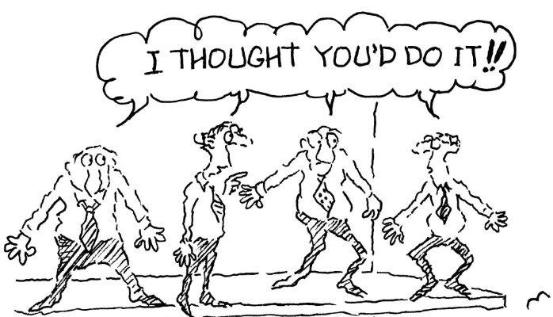
Case study #1
One team member encountered a technical issue. His team leader thinks that this is the responsibility of project technical leader to handle this issue, whereas the technical leader thinks this is the responsibility of his team leader. This resulted in no one handling the issue. In your opinion, what will you do to avoid this issue?

Slide 8

Case study #2
One PM has applied the analogous estimate method for this project because he thinks that it is in the same domain as the project that he did in the past, but he forgot that this project is developed on completely different language. This leads to inaccurate resource estimation. The project team had to overtime for several months. In your opinion, what is the correct estimation approach in this context?

Slide 9
WHAT IS RESOURCE MANAGEMENT?

Slide 10

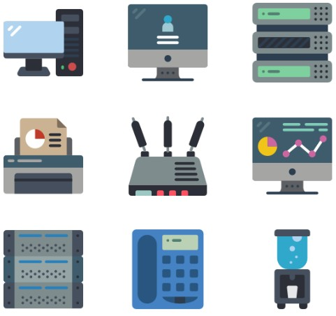

Resource Management Overview
Project Resource Management includes the processes to identify, acquire, and
manage the resources needed for the successful completion of the project.
These processes help ensure that the right resources will be available to the project
manager and project team at the right time and place.

Slide 11
HOW DO WE MANAGE RESOURCE?

Slide 12
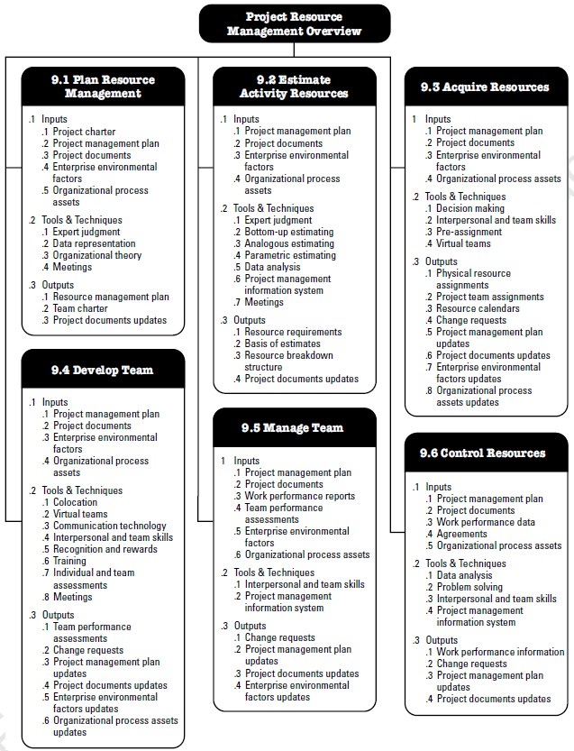
Resource Management Processes

Slide 13
Plan Resource Management
Plan Resource Management is the process of defining how to estimate, acquire,
manage, and use team and physical resources.
INPUTS
TOOLS & TECHNIQUES
OUTPUTS
Project charter
Project management plan
Project documents
Enterprise environmental
factors
Organizational process
assets
Expert judgment
Data representation
Organizational theory
Meetings
Resource management
plan
Team charter
Project documents
updates

Slide 14
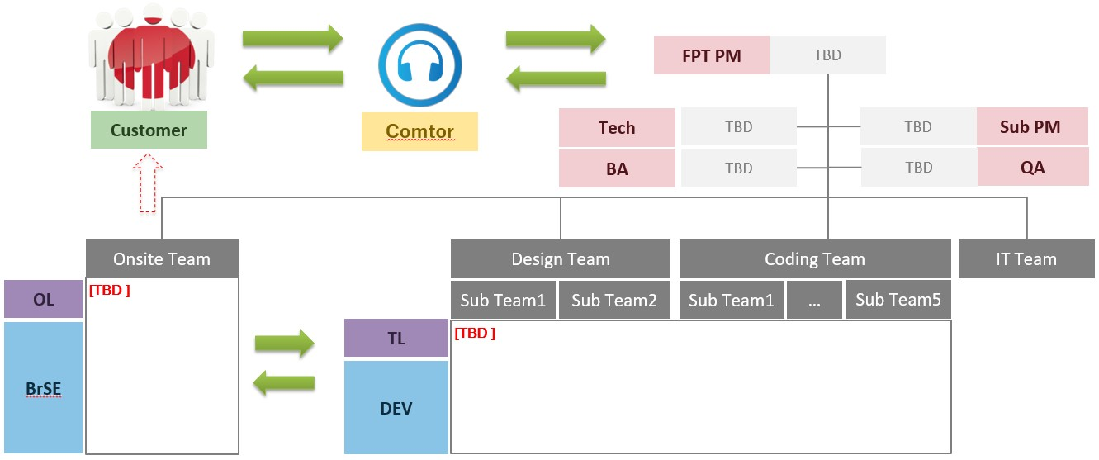
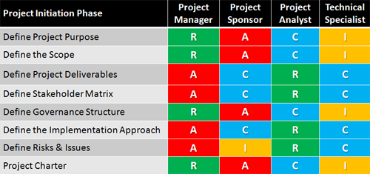
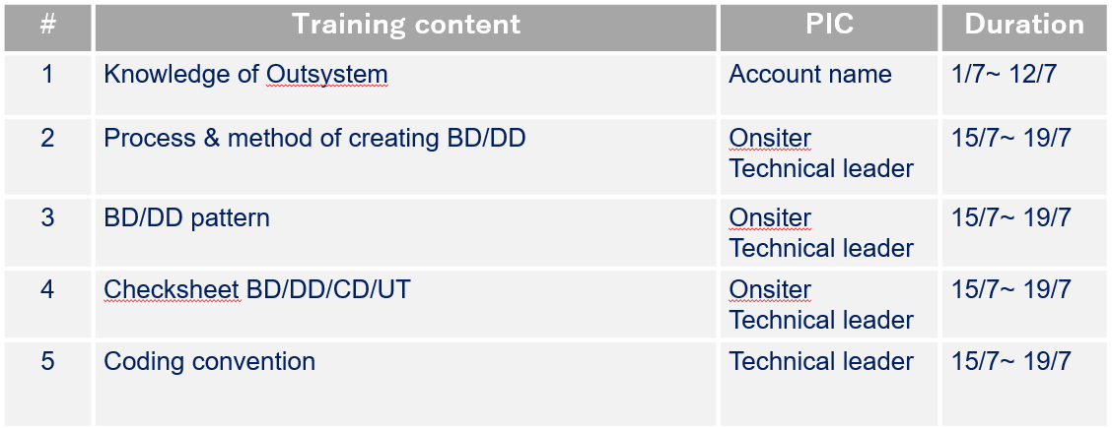
Output: Resource Management Plan
Organization Structure
Role & Responsibility
Training Plan

Slide 15
Estimate Activity Resources
Estimate Activity Resources is the process of estimating team resources and the type
and quantities of materials, equipment, and supplies necessary to perform project work.
INPUTS
TOOLS & TECHNIQUES
OUTPUTS
Project management plan
Project documents
Enterprise environmental
factors
Organizational process
assets
Expert judgment
Bottom-up estimating
Analogous estimating
Parametric estimating
Data analysis
Project management information system
Meetings
Resource requirements
Basis of estimates
Resource breakdown
structure
Project documents
updates

Slide 16
Technique: Estimation Method
Bottom-up estimating
Resources are estimated at the activity level and then aggregated to develop the estimates for
work packages, and summary project levels.
Example: If a project includes 10 work packages and each work package needs 200 hours to be
completed, it will take 2000 hours to finish this project.
Analogous estimating
Use information regarding resources from a previous similar project as the basis for
estimating a future project.
Example: If it need 2,000 hours to develop a website a few months ago and you are responsible
for developing a new similar website, you estimate it need 2,000 hours to finish.
Parametric estimating
Use an algorithm or a statistical relationship between historical data and other variables to calculate resource quantities needed for an activity, based on historical data and project parameters.
Example: If an activity needs 4,000 hours of coding and it needs to finish it in 1 year, it will
require two people to code (each doing 2,000 hours a year).

Slide 17
Output: Resource Requirements
Identify the types and quantities of resources required for project.
Resource Histogram
60
50
40
30
20
10
0
Jan
Feb
Mar
Tester BA
Apr
Comtor QA
May
Jun
PM Dev
Template: Refer file PME_Resource_Ramup_Plan.xlsx

Slide 18
Acquire Resources
Acquire Resources is the process of obtaining team members, facilities, equipment,
materials, supplies, and other resources necessary to complete project work.
INPUTS
TOOLS & TECHNIQUES
OUTPUTS
Project management plan
Project documents
Enterprise environmental factors
Organizational process assets
Decision making
Interpersonal and team skills
Pre-assignment
Virtual teams
Physical resource
assignments
Project team assignments
Resource calendars
Change requests
Project management plan
updates
Project documents updates
Enterprise environmental
factors updates
Organizational process
assets updates

Slide 19

Technique: Decision Making
Criteria are developed and used to rate or score potential resources:
Availability
Cost
Ability
Experience
Knowledge
Skills
Attitude
International factors

Slide 20
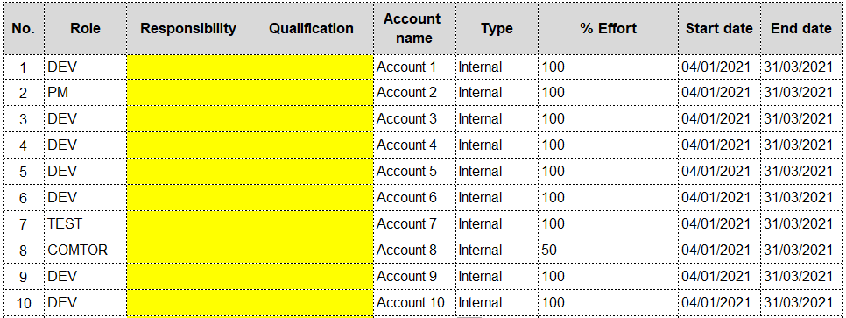
Output: Team Assignments

Slide 21
Develop Team
Develop Team is the process of improving competencies, team member interaction,
and the overall team environment to enhance project performance.
INPUTS
TOOLS & TECHNIQUES
OUTPUTS
Project management plan
Project documents
Enterprise environmental
factors
Organizational process assets
Colocation
Virtual teams
Communication technology
Interpersonal and team skills
Recognition and rewards
Training
Individual and team
assessments
Meetings
Team performance
assessments
Change requests
Project management plan updates
Project documents updates
Enterprise environmental factors updates
Organizational process
assets updates

Slide 22

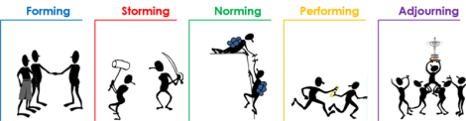
Output: Team Performance Assessment
Improve in skills
Improve in competencies
Reduce turnover rate
Increase team cohesiveness

Slide 23
Manage Team
Manage Team is the process of tracking team member performance, providing feedback, resolving issues, and managing team changes to optimize project performance.
INPUTS
TOOLS & TECHNIQUES
OUTPUTS
Project management plan
Project documents
Work performance
reports
Team performance
assessments
Enterprise environmental
factors
Organizational process assets
Interpersonal and team
skills
Project management
information system
Change requests
Project management plan
updates
Project documents updates
Enterprise environmental
factors updates

Slide 24
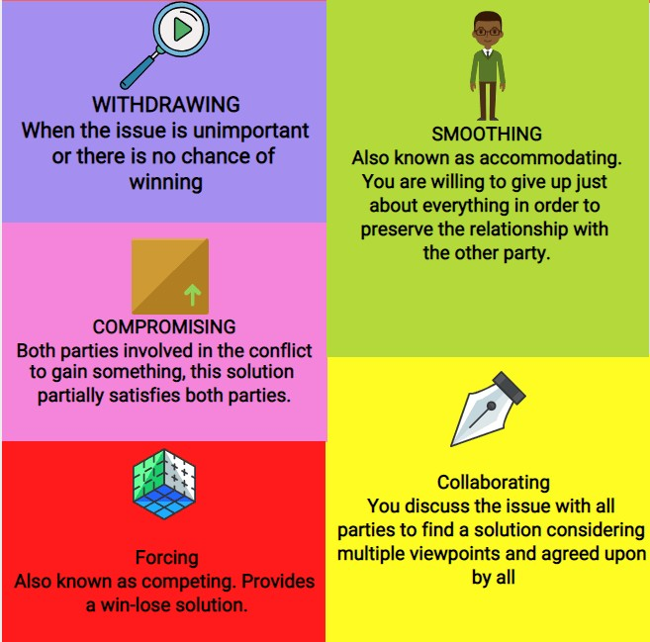
Technique: Interpersonal and team skills
Conflict management

Slide 25
Control Resource
Control Resources is the process of ensuring that the physical resources assigned and allocated to the project are available as planned, as well as monitoring the planned versus actual utilization of resources and taking corrective action as necessary.
INPUTS
TOOLS & TECHNIQUES
OUTPUTS
Project management plan
Project documents
Work performance data
Agreements
Organizational process
assets
Data analysis
Problem solving
Interpersonal and team
skills
Project management
information system
Work performance
information
Change requests
Project management plan
updates
Project documents
updates

Slide 26

Technique: Problem solving
Identify
Define
Investigat e
Analyze
Solve
Re-Check
Identify specific problem
Break problem to smaller,
manageable
problems
Collect data
Find root-
cause
Choose the
suitable
solution
Problem
fixed or not?

Slide 27
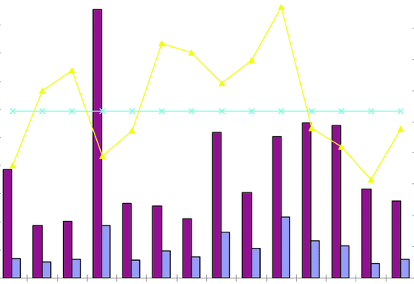
Output: Work Performance Information
Compare resource requirements and resource allocation to resource utilization across the project.

Slide 28
RESOURCE MANAGEMENT IN AGILE

Slide 29



Consideration for Agile model
Collaborative teams are often critical to the success of projects with a high degree of variability and rapid changes, because there is less time for centralized tasking and decision making.
Agile leader is a person who fosters agile ways of thinking and working, creates an environment where teams can do their best work, trust them to get the job done and champions agile throughout their organization.
Resources in the Agile project should be allocated full time and
remain stable.

Slide 30
SUMMARY

Slide 31








Summary
Define clear resource requirement
Create training plan that suitable for teams
Conflict resolving with open mind
ONLY get resource qualify
resource requirement
ALWAYS think about motivate
members
Control resource as a
continuous progress

